Slide 1
Music and Personality
Abraham Do

Slide 2
Goal (What I am trying to determine)
Is it truly possible to find any sort of direct correlation between music and its respective listeners through the analyzation of a dataset?

Slide 3
Dataset Used
A 2013 survey conducted on college students in the UK
Has 150 different variables along with over a thousand responses each
Will only be focusing on a fraction of the dataset as many of the data is irrelevant to what I am trying to prove.
All survey answers are based on a scale of 1 to 5, with 1 being least favorable to 5 being most favorable.

Slide 4
Variables Implemented (.iloc)
Music: The constant variable which I am using to find correlations within the dataset
Math: Math, Physics
Science: Psychology, Biology, Chemistry
Spending: Shopping Centers, Branded Clothing, Partying/Socializing, Appearance, Gadgets
Active: Outdoor Activities, Passive Sports, Active Sports, Adrenaline Sports
Religion: Religious, Belief in God

Slide 5
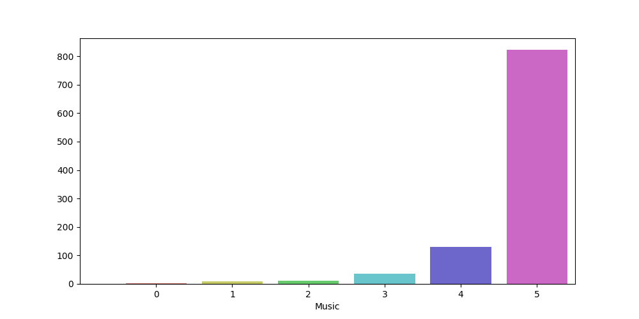
Countplot Analysis of Music

Slide 6
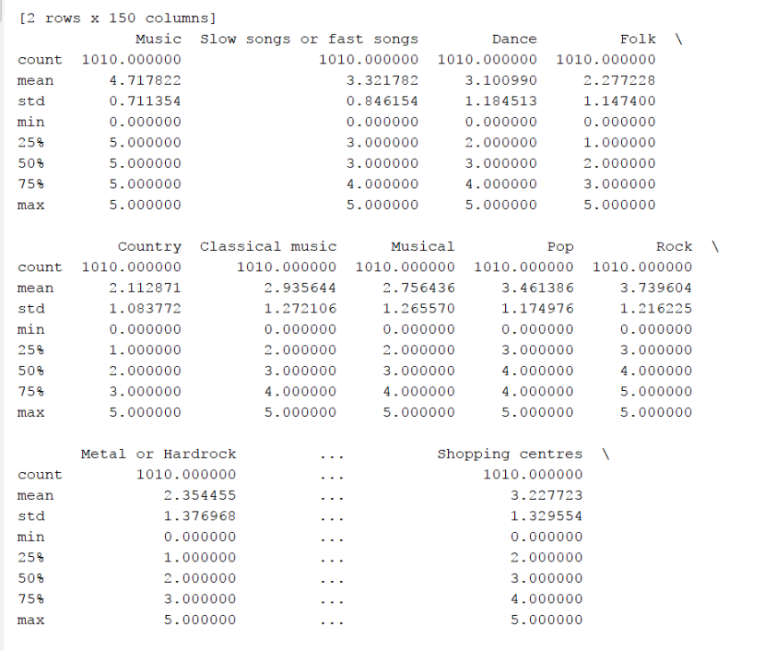
Survey.Describe()

Slide 7
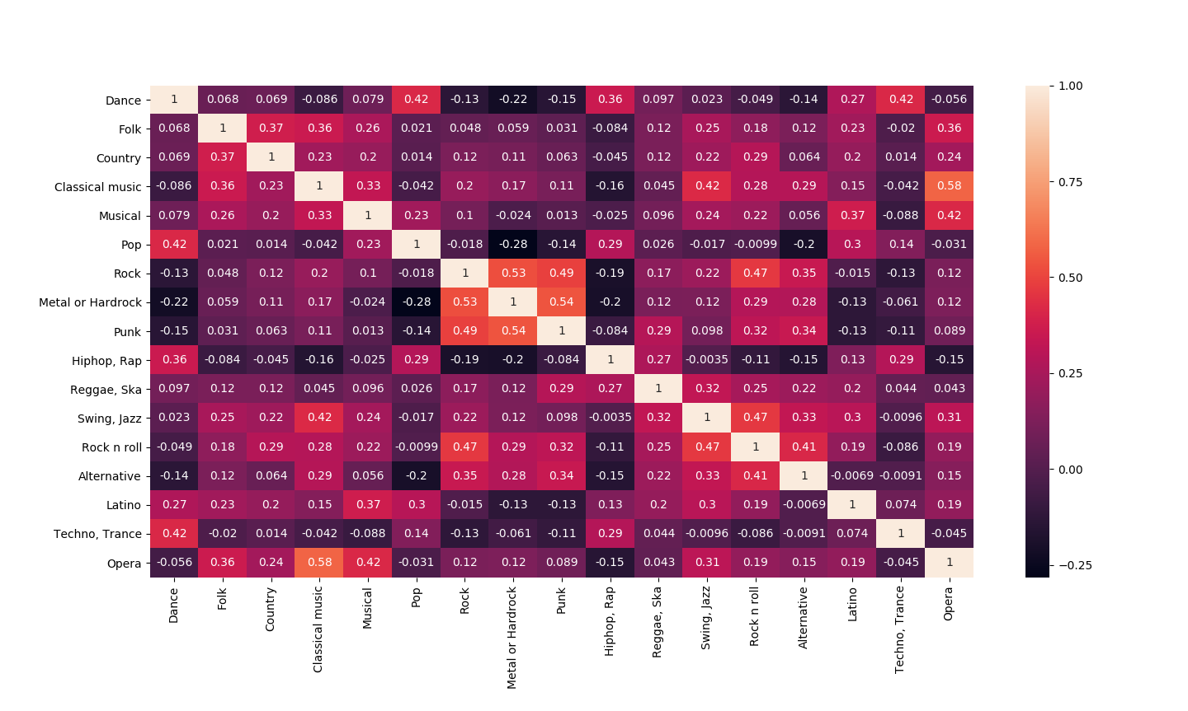
Heatmap Analysis
Strongest Correlations:
Classical/Opera
Punk/Metal
Rock/Swing,Jazz
Weakest Correlations:
Metal/Pop
Metal/Dance
Alternative/Pop
Will people listen to music that
closely relate to each other?

Slide 8
Linear Regression
Linear Regression is used to determine the extent to which there is a linear relationship between a dependent variable and one or more independent variables
In this case, I will be comparing Music to all of the other variables to obtain a linear relationship.

Slide 9
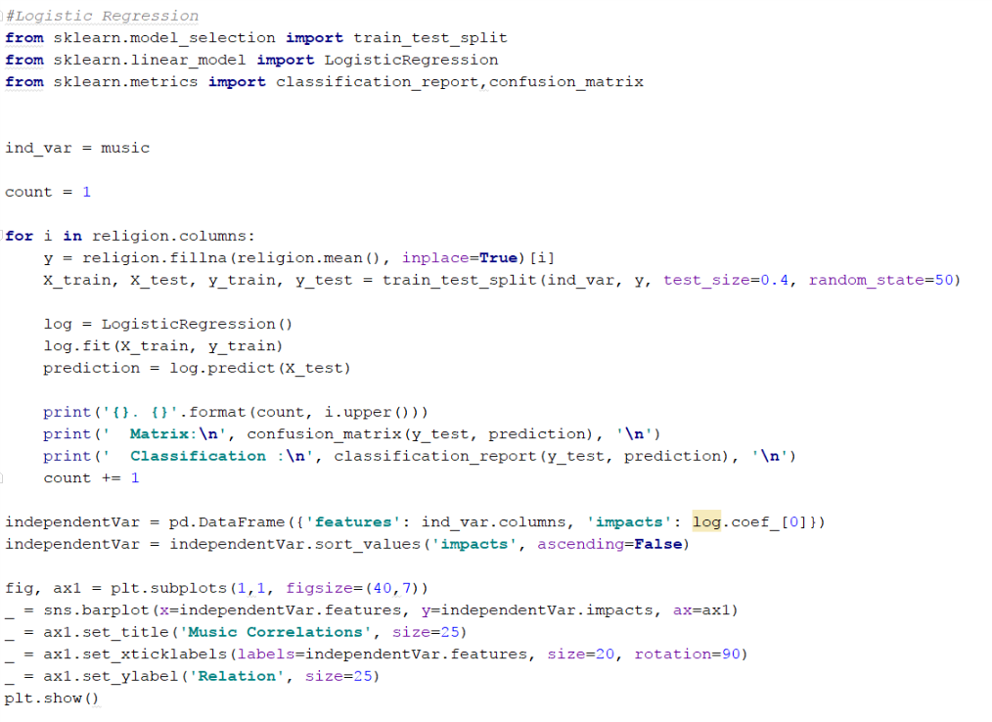

Slide 10
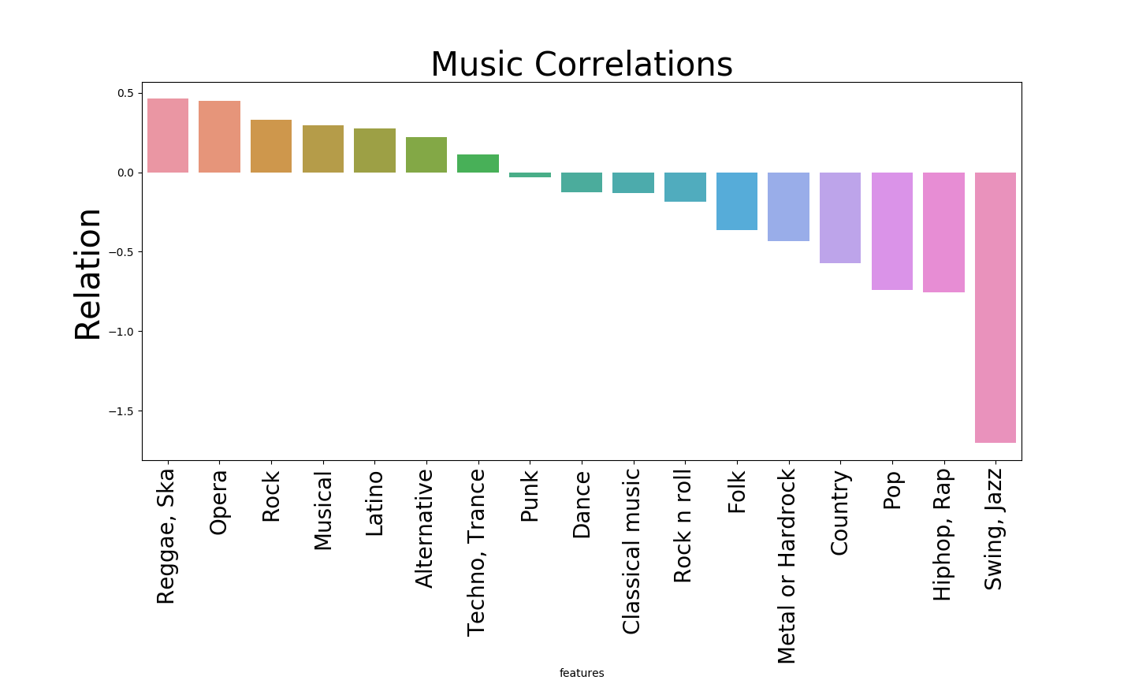
Music vs Math
Metal has a negative correlation
With punk. Should be similar.
Rock should be similar to Swing,Jazz,
But is very different
Opera and Classical are also Positive &
Negative, should be similar.
Metal is similar to Dance and Pop. Are
Supposed to be drastically different.
Notable Relations
Reggae

Slide 11
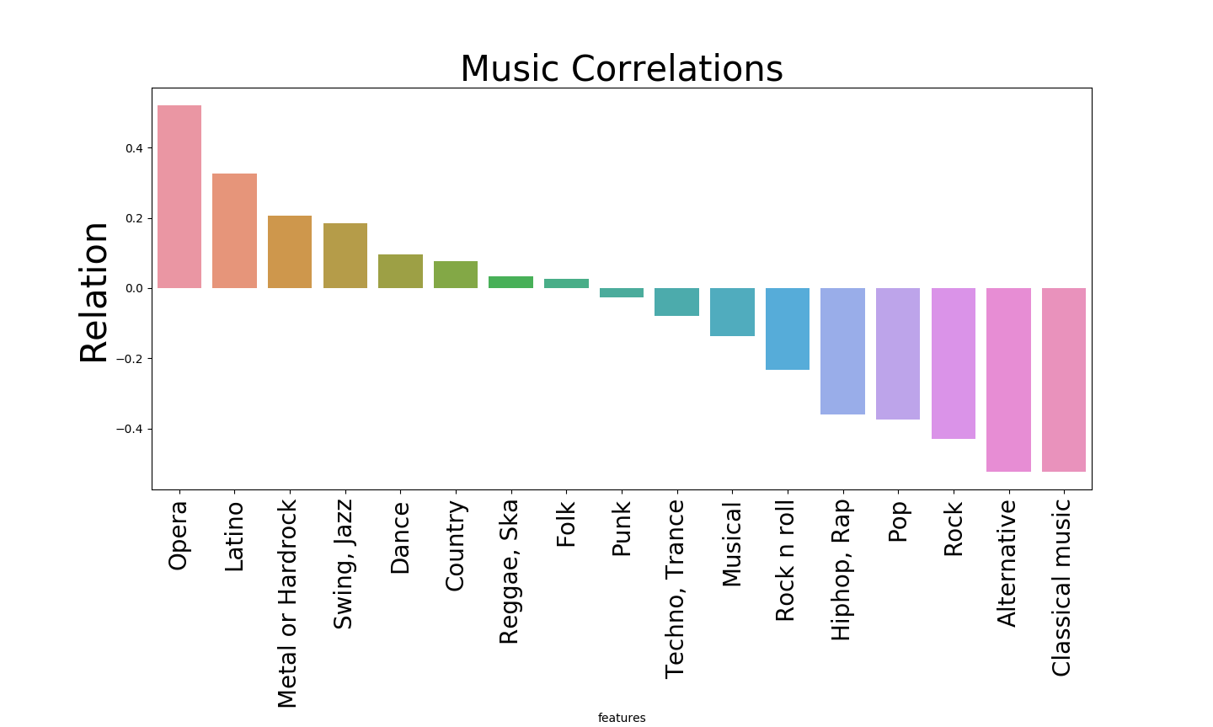
Music vs Science
Classical and Opera are polar opposites.
Should be similar.
Similarly to Swing,Jazz and Rock.
Metal and Dance are both positive,
Should be different.
Notable Relations
Classical/Opera
Latino

Slide 12
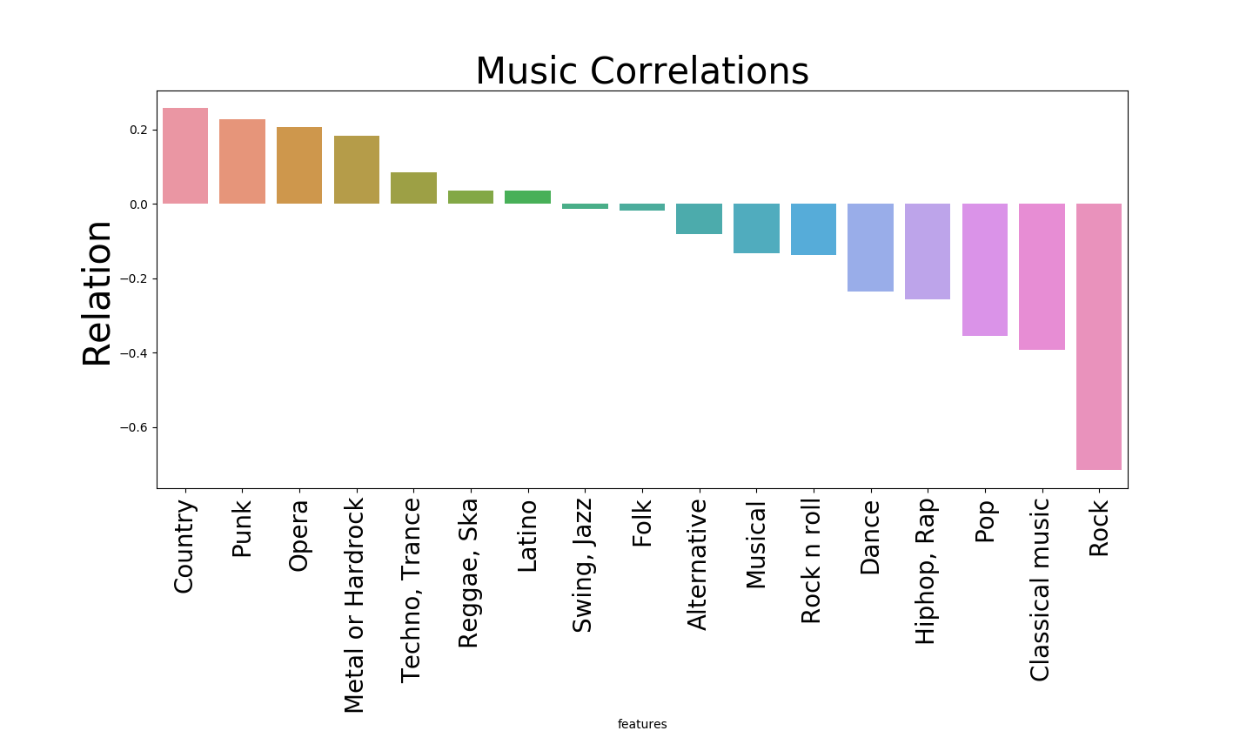
Music vs Spending
Classical and Opera should be similar
Swing,Jazz and Rock are both negative,
But still very different from one another.
Notable Relations
Country
Punk
Metal
Classical

Slide 13
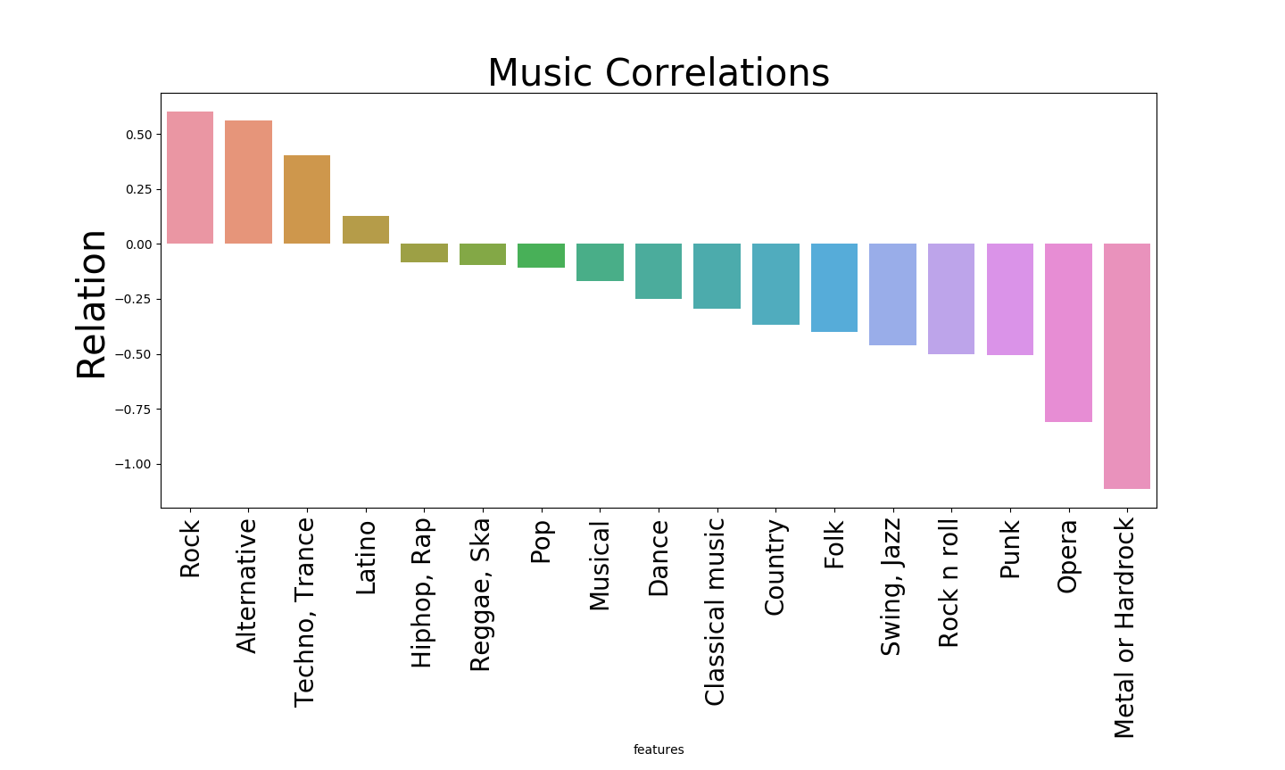
Music vs Active
Rock and Swing,Jazz are very different
Should be similar.
Metal and Pop are both negatively
Related. Should be different.
Side note: If anyone can explain the
Difference between Rock and Rock n
Roll to me I’d really appreciate it!
Thought they were the same but
Clearly not according to this graph.
Notable Relations
One of the more normal correlations

Slide 14
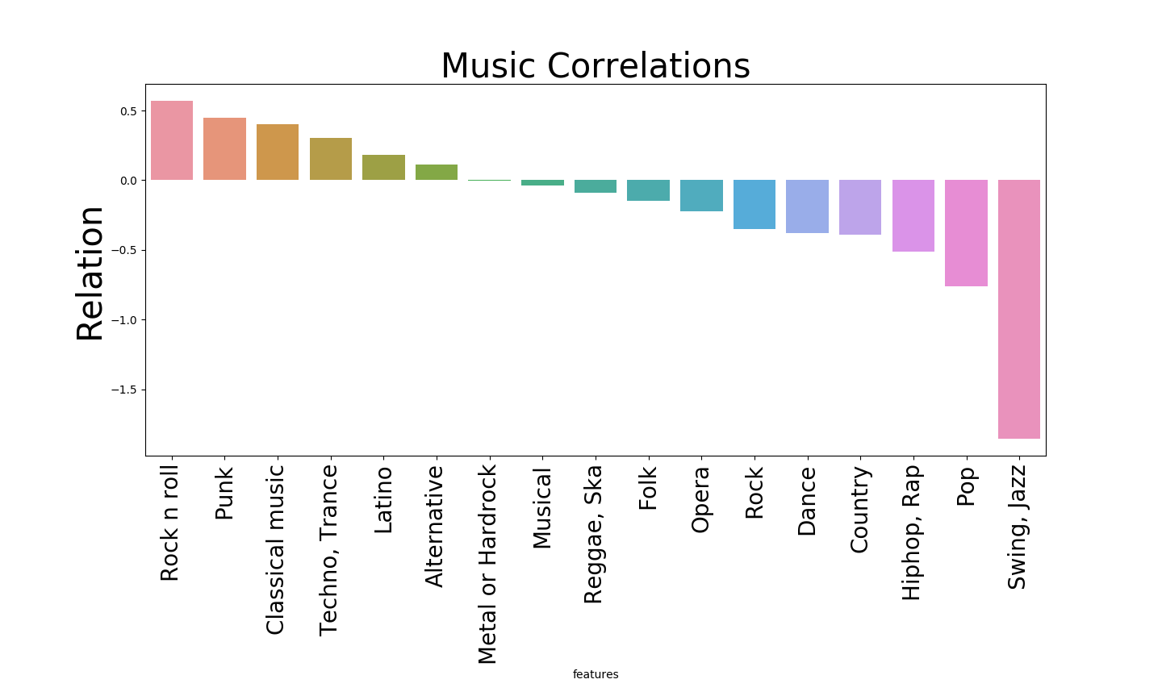
Music vs Religion
Classical and Opera should be similar
Notable Relations
Punk
Latino

Slide 15
Top vs Worst (What I expected to be Top)
Math: Reggae vs Swing (Pop)
Science: Opera vs Classical (Pop)
Spending: Country vs Rock (Classical)
Active: Rock vs Metal (Hiphop)
Religion: Rock n Roll vs Swing/Jazz (Musical)

Slide 16
Conclusions
It is more common for music that is supposed to be similarly related be different, as is the case with Opera and Classical being different in 3 of the five tests, and Rock and Swing,Jazz being different in 4 of the 5 tests.
A majority of the music came down to be as expected depending on the variables, but there will always be noisy data that will make certain data pop out unexpectedly.
It is important to note however that this noisy data is still human preference of music, and therefore it can be determined that although algorithms may be able to give us an accurate description of what a particular person may enjoy, they will never be 100% accurate as music taste can be unpredictable at times.

Slide 17
Adjustments and Issues
Until Thursday night, I will be attempting to replicate these results on at least another algorithm or two to see the results that come forward. (i.e Random Forest, PCA, and XGBoost)
Figuring out how to properly categorize the variables was difficult, and implementing the actual algorithm became extremely troublesome as the project progressed.
If I were to repeat this task, I would use a more local dataset rather than a UK one to get more relatable results. Furthermore, I would attempt to gain a larger sample set to increase the total accuracy of my project.

Slide 18
Thank you

